Slide 1
Neural Architecture Search with Reinforcement Learning
Google 2017

Slide 2
Introduction
Background
Method
Experiment

Slide 3
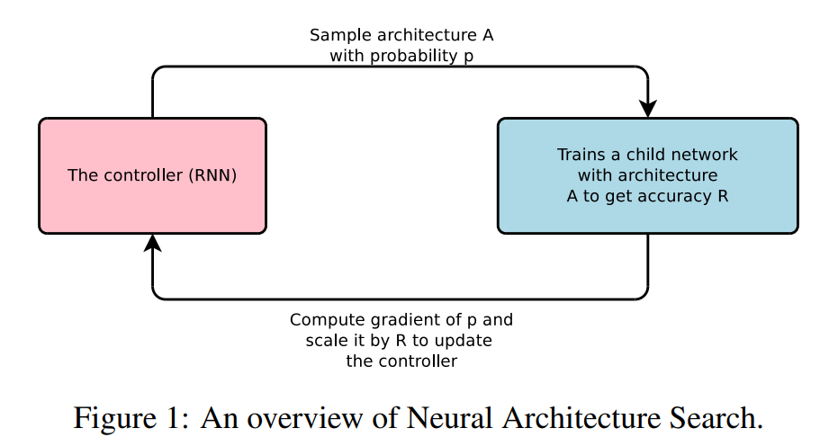
Introduction
To design neural network, introduce RNN that produces model architecture
CNN.
Kernel_size
Padding etc.

Slide 4
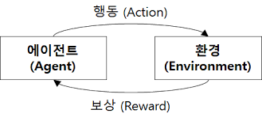
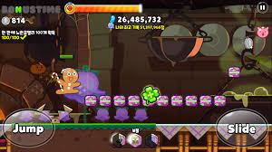
Background
Reinforcement learning
Agent -> Action -> Reward

Slide 5
Background
Policy
Probability of action

Slide 6

Background
Episode
1 episode :

Slide 7
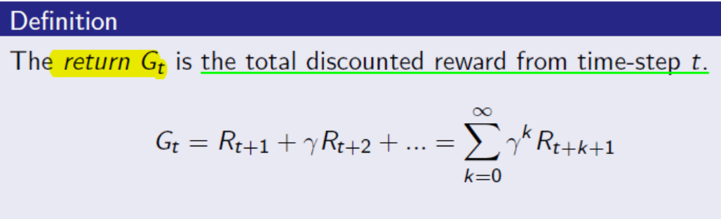
Background
Objective function
Maximizing cumulative reward until the end of termination
Cumulative reward

Slide 8
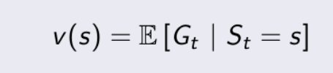
Background
Cumulative reward
Value function

Slide 9
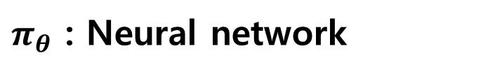

Background
Policy gradient
Use gradient in that way to approximate the policy
Policy gradient – objective function
$$J\left(θ\right)=E_{π_{θ}}\left[G_{0}\right]=E_{π_{θ}}[V_{0}]$$
$π_{θ}$ : Neural network

Slide 10
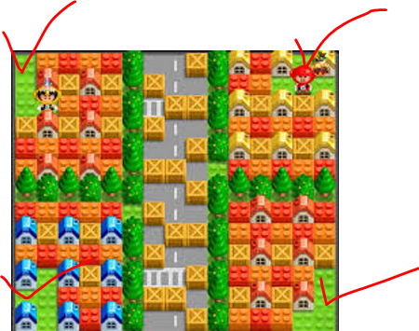
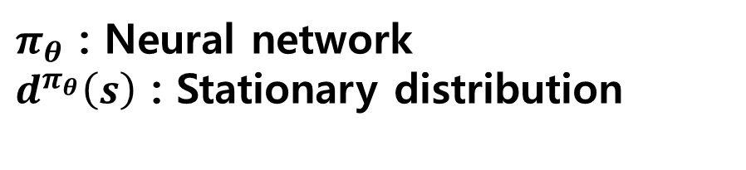

Background
Policy gradient – objective function
$$J\left(θ\right)=E_{π_{θ}}\left[V_{0}\right]= \sum_{S}{d^{π_{θ}}\left(s\right){\sum_{A}{π_{θ}(s,a)}R_{S}^{a}}^{}}$$
$π_{θ}$ : Neural network
$d^{π_{θ}}\left(s\right)$ : Stationary distribution

Slide 11

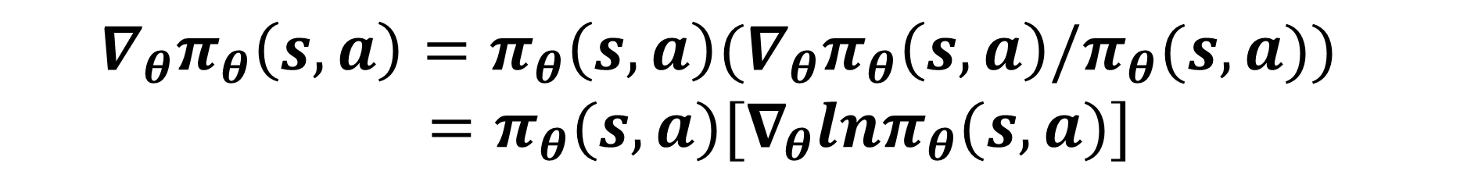
Background
Policy gradient – objective function
$${∇_{θ}π}_{θ}\left(s,a\right)=π_{θ}\left(s,a\right){{(∇}_{θ}π}_{θ}\left(s,a\right)/π_{θ}(s,a)) \\ =π_{θ}(s,a){[∇}_{θ}lnπ_{θ}(s,a)]$$

Slide 12

Background
Policy gradient – objective function
$$∇_{θ}J\left(θ\right)= \sum_{S}{d^{π_{θ}}\left(s\right){\sum_{A}{{∇_{θ}π}_{θ}(s,a) }R_{S}^{a}}^{}}$$
$$=\sum_{S}{{d^{π_{θ}}\left(s\right)\sum_{A}{π_{θ}(s,a){[∇}_{θ}lnπ_{θ}(s,a)]}R_{S}^{a}}^{}}$$
$π_{θ}$ : Neural network
$d^{π_{θ}}\left(s\right)$ : Stationary distribution

Slide 13
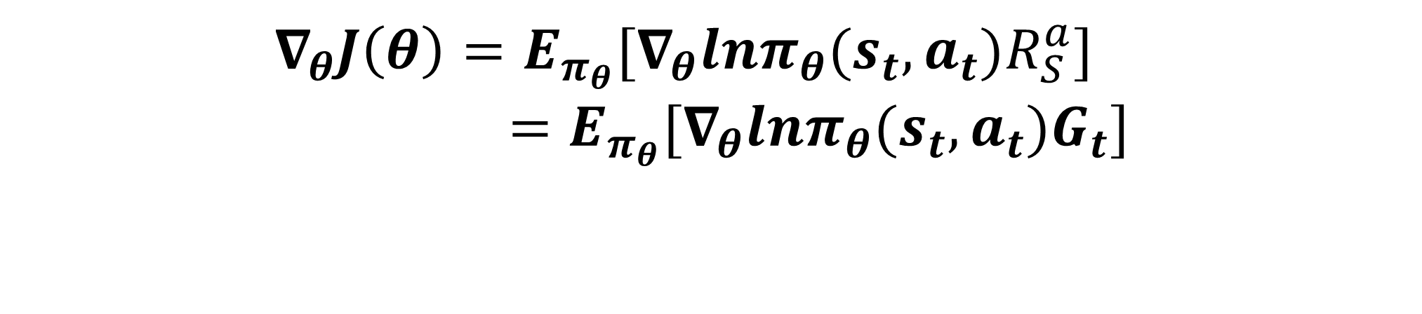
Background
Policy gradient – objective function
$$∇_{θ}J\left(θ\right)=E_{π_{θ}}{{[∇}_{θ}lnπ_{θ}(s_{t},a_{t})R_{S}^{a}] }^{}$$ $=E_{π_{θ}}{[∇}_{θ}lnπ_{θ}(s_{t},a_{t})G_{t}]$
Action을 할 확률을 바꾸는데, G를 많이 받으면 받을수록 해당 action을 더 하게끔 바꾼다.
$π_{θ}$ : Neural network
$d^{π_{θ}}\left(s\right)$ : Stationary distribution

Slide 14

Background
Policy gradient – objective function
$${θ=θ+ α∇}_{θ}J\left(θ\right)$$
Action을 할 확률을 바꾸는데, G를 많이 받으면 받을수록 해당 action을 더 하게끔 바꾼다.
$π_{θ}$ : Neural network
$d^{π_{θ}}\left(s\right)$ : Stationary distribution

Slide 15
Method

Slide 16
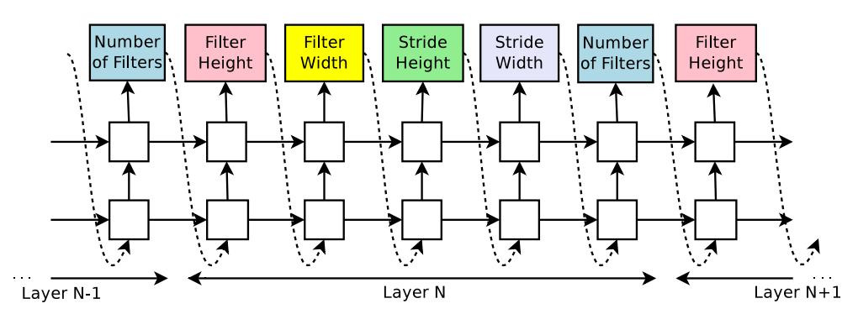
Method : Controller
Generate architecture hyperparameters of neural networks
For CNN,
Every prediction is carried out by a softmax classifier

Slide 17
Method : Child network
Given hyperparameter from controller, child network start training
When child network converges, it delivers validation accuracy
Validation accuracy = reward

Slide 18

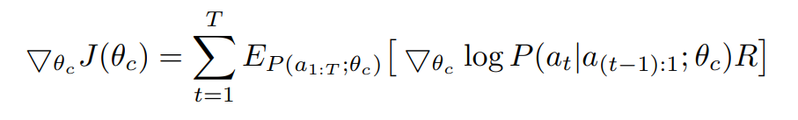
Method : Loss function
Maximize validation accuracy
Reward signal R is non-differentiable
Validation accuracy가 높아지는 방향으로, hyperparameter를 생성

Slide 19
Method : Training

Slide 20
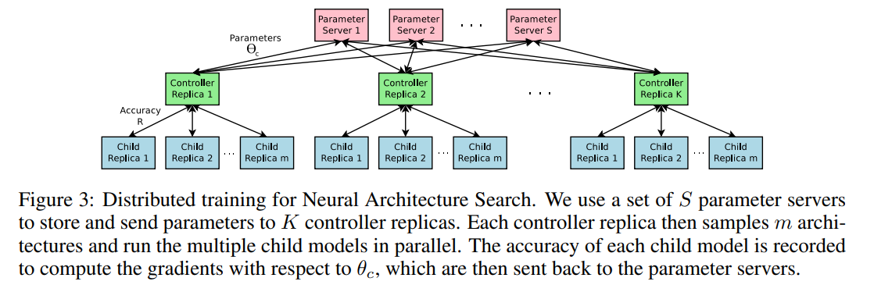
Method : Training
Parallelism and Asynchronous Updates

Slide 21
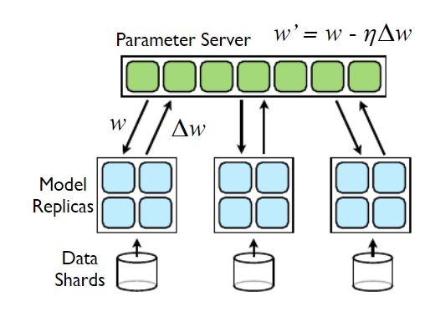
Method : Training
<Large Scale Distributed Deep Networks - 2012>

Slide 22
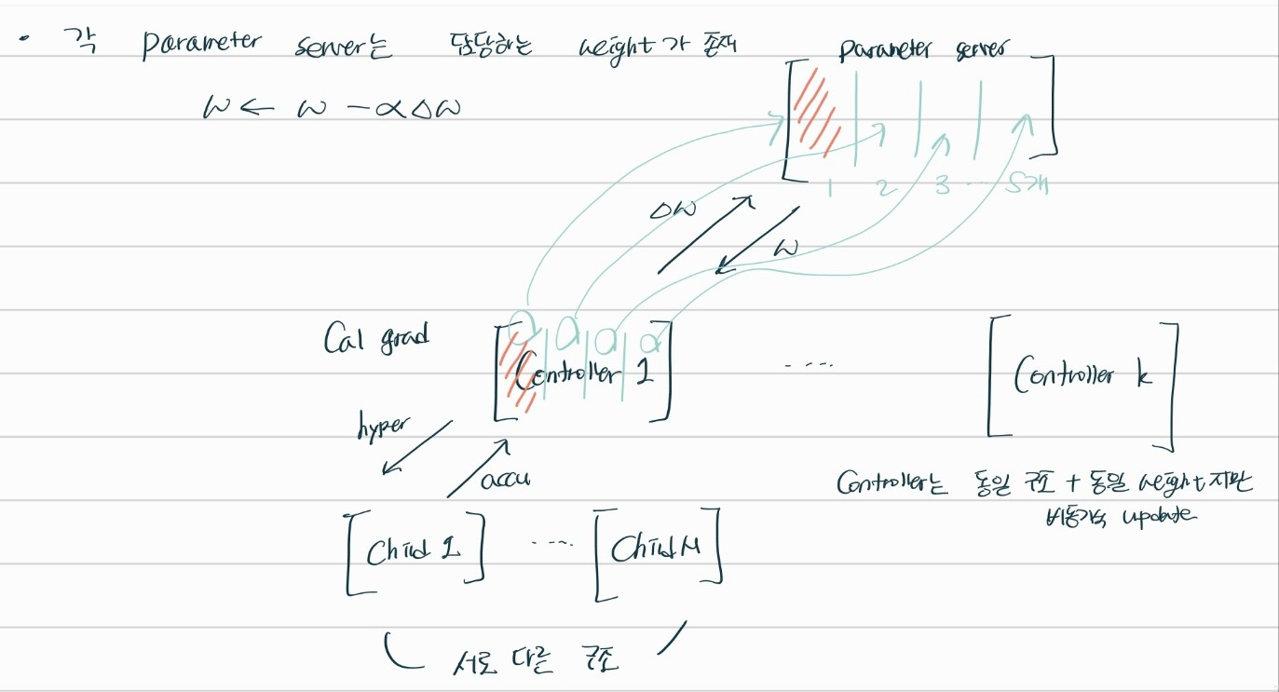
Method : Training

Slide 23
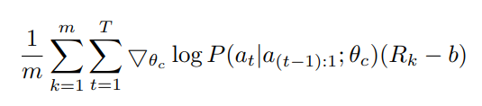
Method : Loss function
Loss에 의해, 모든 child는 동일한 Layer수를 가진다(a : 1~T)
b는 R의 variance를 줄이기 위한 값으로, 이전 architecture의 accuracy의 지수이동 평균 값으로 구성

Slide 24
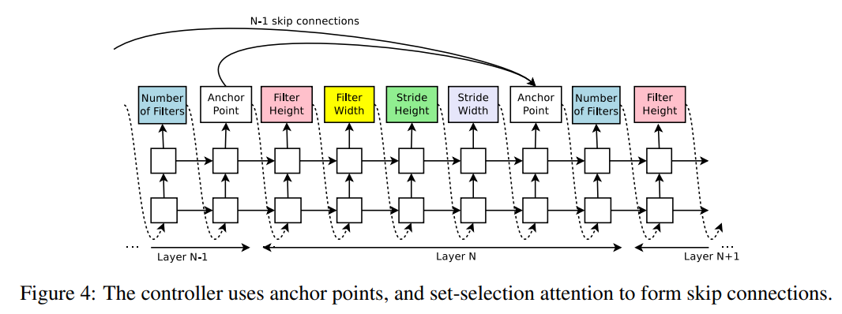
Method : Skip connection

Slide 25
Method : Skip connection

Slide 26
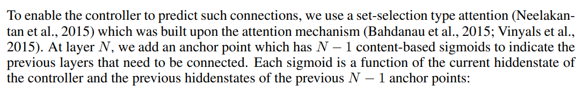
Method : Skip connection

Slide 27
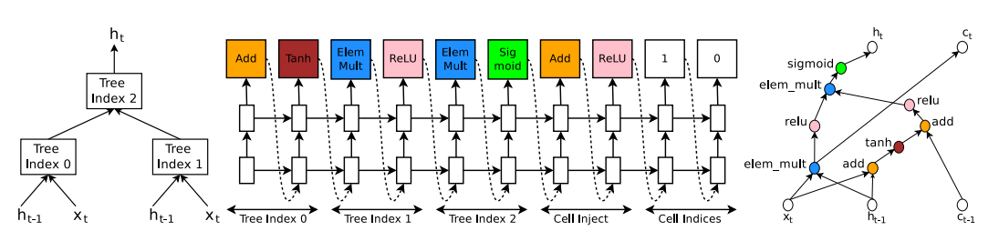
Method : Controller
For RNN, inspired by the construction of the LSTM cell

Slide 28
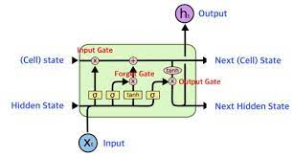
Method : Controller
For RNN, inspired by the construction of the LSTM cell

Slide 29





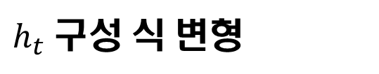
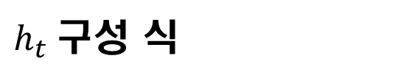
Method : Controller
Index a
하나의 cell
a0
a1
$h_{t}$구성 식
$h_{t} 구성 식 변$형
$$x_{t},h_{t−1},c_{t−1}→h_{t},c_{t}$$

Slide 30
Experiment
For CNN,
Filter height : [1, 3, 5, 7]
Filter width : [1, 3, 5, 7]
Number of filters : [24, 36, 48, 64] etc.
Controller RNN is a two layer LSTM with 35 hidden units

Slide 31
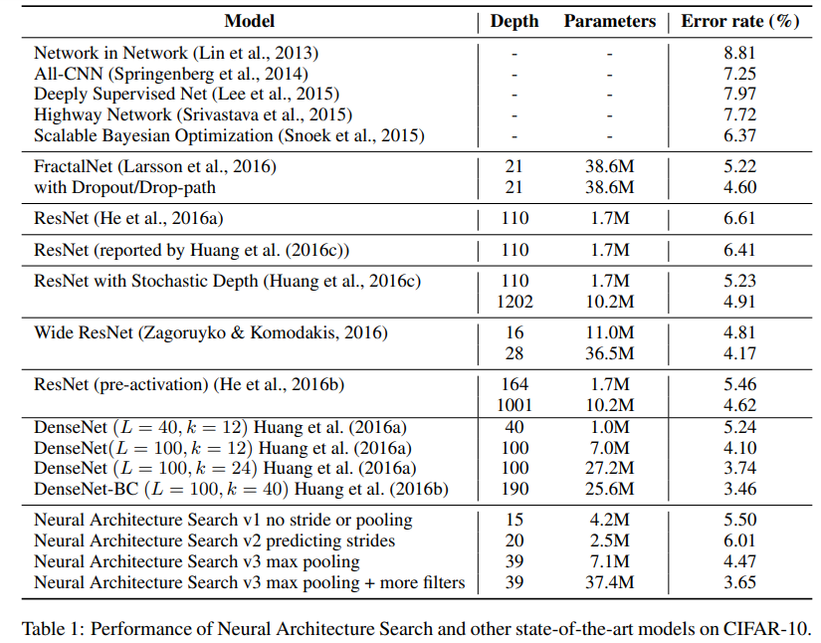
Experiment
Good balance between accuracy and depth

Slide 32
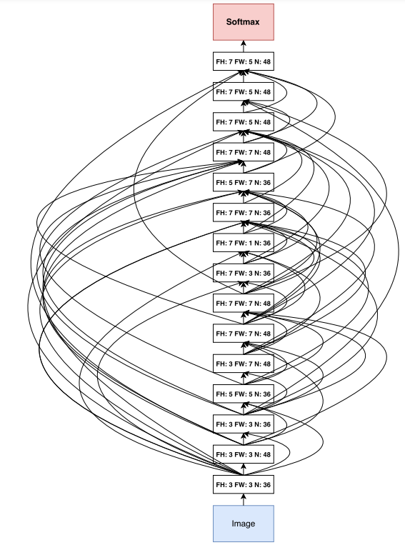
Experiment
Many rectangular filters
Larger filters at the top layers

Slide 33
Limitation
If Search space is large, more challenging

